Slide 1

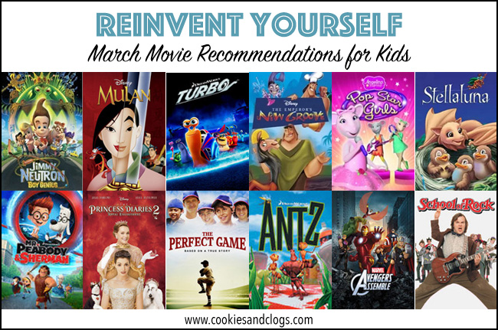
CMSC5741 Big Data Tech. &Apps Topic: A Simple Movie Recommendation System
Professor: | Michael R. Lyu
Prepared by: | Team 2 1155101156 1155105483 1155101677 1155105238
Submit Date: | Nov. 1st, 2017

Slide 2
用这个
http://blog.csdn.net/qq_20282263/article/details/52692318

Slide 3
介绍数据集
Motivation
做这个proj用了什么techniques.
遇到什么问题
介绍结果
每个人大概讲2.5-3分钟

Slide 4
Motivation
Everyone have different personal preferences and taste to movies, want to see if we can find someone that have similar taste of movies to him/her.
Want to apply the recommender systems techniques we have learned in the lecture to solve practical problems.
//TODO

Slide 5
Introduction to the Dataset
Movielen //TODO

Slide 6
Techniques we have used.
HADOOP – Pre-process of data and Post-process of our results.
Pre-process: ratings.dat contains timestamp which have no use of our computation. Use Hadoop to eliminate all the timestamp of all ratings.
Post-process: ratings.dat contains only movie ID which we need to go to movies.dat to find out what categories and name of that movie. We use Hadoop to join the two file to find the relevant movie names and categories.

Slide 7
CF(collaborative filtering)
Compute the similarity of all users to our user.
First find out which user watch the same movie (some taste) of our user
Loop to find the similarity of them.
Compute the cos-distance of them, use this to find the similarity.

Slide 8
Some recommender systems methods.
//TODO

Slide 9
Problems encountered
Originally we want to

Slide 11
References:
https://www.google.com.hk/search?q=movie+recommendations&source=lnms&tbm=isch&sa=X&ved=0ahUKEwjpvYLFjM_XAhUBOJQKHTRiBm4Q_AUICigB&biw=1920&bih=949#imgrc=_

